Slide 1
I399 Web Design
Lab 3

Slide 2
Documentation Scavenger Hunt
Today you will be turning in your finished document on Canvas for credit at the end of class. We’ll go through the solutions in class next week.
Work with a partner, put both of your names on the document, but please EACH turn your document in.
We want you to find solutions that use HTML/CSS, even then, there may be more than one way to complete the task.
Evaluate the sources you find. Don’t assume the first site is correct. Be skeptical. Figure out what the effect is called and you’ll find multiple sources for how to do it in HTML/CSS.
Notes:
AIs

Slide 3
Documentation Scavenger Hunt
DIRECTIONS For each Scavenger Hunt item, search for the answers online:
Pick what you think are the BEST 3 or 4 sources you found
List the URLs and rank them
Write a paragraph or two about why you chose those resources and why you ranked the resources in the order you did. -- What exactly were these resources deemed useful? -- How confident are you that your top solution will work?
Notes:
AIs

Slide 4
Documentation Scavenger Hunt
#1 You have two words on your web page that need to stay together on the same line no matter what. We do want web content to flow within changing container sizes, but in this case, these two words should never be separated by a new line.
Find a way to do this...
OK Welcome to Indiana University
OK Welcome to
Indiana University
NOT OK Welcome to Indiana
University
Notes:
AIs

Slide 5
Documentation Scavenger Hunt
#2 You don’t have official content for your site yet, but you know you need several paragraphs worth of text.
How might you generate filler text for use during the design and planning stages of development?
Find a way to do this...
Pellentesque habitant morbi tristique senectus et netus et malesuada fames ac turpis egestas. Vestibulum tortor quam, feugiat vitae, ultricies eget, tempor sit amet, ante. Donec eu libero sit amet quam egestas semper. Aenean ultricies mi vitae est. Mauris placerat eleifend leo. Quisque sit amet est et sapien ullamcorper pharetra.
Notes:
AIs

Slide 6


Documentation Scavenger Hunt
#3 You want to have two images in the background. We could combine these images with Photoshop, but our background would be huge and would impact loading speeds.
Find a way to display more than one background image.
How might we do this?
Notes:
AIs

Slide 7
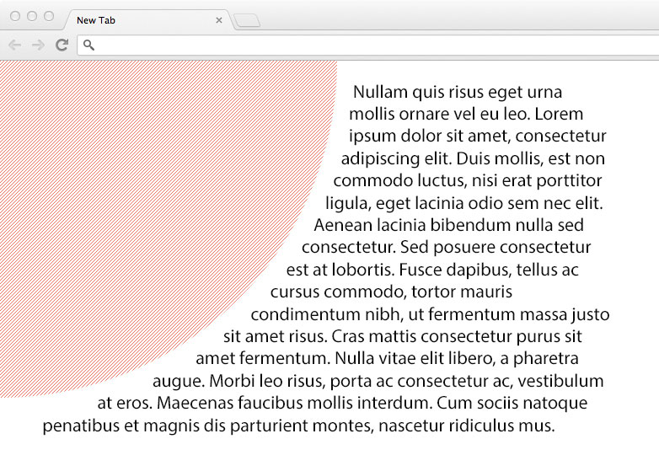
Documentation Scavenger Hunt
#4 We have a circular graphic and a bunch of text. Is there a way to have our text to follow the contour of the shape?
How might we do this?
Note: the current solution only works in webkit browsers like Chrome and Safari.
Notes:
AIs

Slide 8
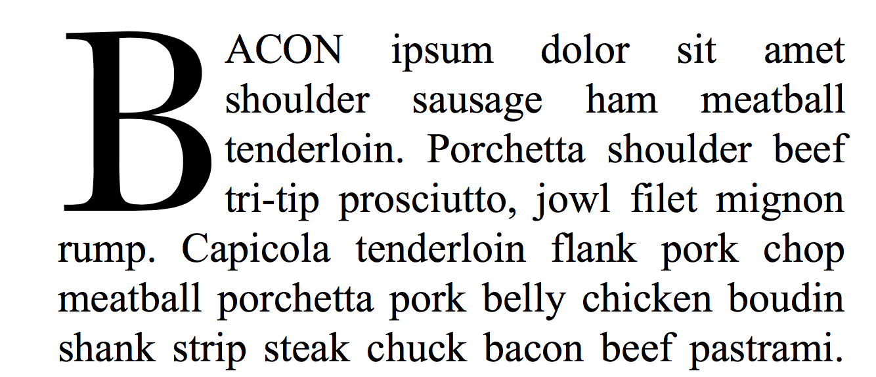
Documentation Scavenger Hunt
#5 How do we make our stories online look better? One way is to mimic the layout and graphic details of books. Find a way to make a dropcap for the first letter in the first paragraph.
How might we do this?
Notes:
AIs

Slide 9

Documentation Scavenger Hunt
#6 One of the big design trends is flat design, but sometimes this leads to confusion. We want to mimic the Google Material look (below).
Find a way to add a drop shadow to our <div class=”container>.
How might we do this?
Notes:
AIs

Slide 10
Finished?
Make sure you have a ranked list of URLS for each task.
As well as your statement on why you trust/don’t trust the solution(s) that are your top picks.
And the names of the people in your group.
Upload your Scavenger Hunt document to Lab 3 on Canvas.

